Slide 1

ES5: JS Essentials & JS Behind the Scenes
Himanshu
Notes:
y

Slide 2
Agenda
JS Introduction
Variables
Operators
Conditions & Loops
Array
Object
Global Execution Context And Global Object
Scope
Hoisting
this keyword
HTML5 APIs (Local,Session Storage and Cookies)
JSON & AJAX

Slide 3
What is JavaScript?
JavaScript (JS) is a lightweight programming language that runs through interpretation or just-in-time compilation and supports first-class functions.
Designed to add interactivity to HTML pages
Scripting language
Usually embedded directly into HTML pages
Interpreted language (executes without compilation)
Notes:
JIT (Just-In-Time Compilation) is a compilation process in which code is translated from an intermediate representation or a higher-level language (e.g., JavaScript or Java bytecode) into machine code at runtime, rather than prior to execution.
A programming language is said to have First-class functions when functions in that language are treated like any other variable. For example, in such a language, a function can be passed as an argument to other functions, can be returned by another function and can be assigned as a value to a variable.
Interpretation in programming means that the source code of a program is read and executed line by line by an interpreter, instead of being fully converted into machine code beforehand (as in compilation).
A scripting language is a type of programming language that is interpreted rather than compiled
An object-oriented scripting language is a scripting language that supports the principles of object-oriented programming (OOP) — such as classes, objects, inheritance, and encapsulation — while still being interpreted rather than compiled.

Slide 4
What can a JavaScript do?
Can put dynamic text into an HTML page - A JavaScript statement like this: document.write("<h1>" + name + "</h1>") can write a variable text into an HTML page.
Can react to events - A JavaScript can be set to execute when something happens, like when a page has finished loading or when a user clicks on an HTML element.
Can read and write HTML elements - A JavaScript can read and change the content of an HTML element.
Can be used to validate data - A JavaScript can be used to validate form data before it is submitted to a server. This saves the server from extra processing.
Can be used to detect the visitor's browser - A JavaScript can be used to detect the visitor's browser, and - depending on the browser - load another page specifically designed for that browser.
Can be used to create UI.
AND MANY MORE......

Slide 5
Where To And How To Include JavaScript In Your File
There are 3 places where we can write JavaScript in our HTML Document
  In the Head
  In The Body
  In a separate file
Each place has its own pros/cons
Remember JavaScript is Case Sensitive

Slide 6
JavaScript Variables
Same as algebra, JavaScript variables are used to hold values or expressions.
A variable can have a short name, like x, or a more descriptive name like carName.
Rules for JavaScript variable names:
  Variable names are case sensitive (y and Y are two different variables).
  Variable names must begin with a letter or the underscore character.
  Reserved keywords cannot be used as variable's name.
Notes:
Primitive = simple values (copied by value).
Non-primitive = complex objects (copied by reference).

Slide 7
Example
var x=5;
var carName="Volvo";
y=x-5;
z=y+5;
Etc..

Slide 8
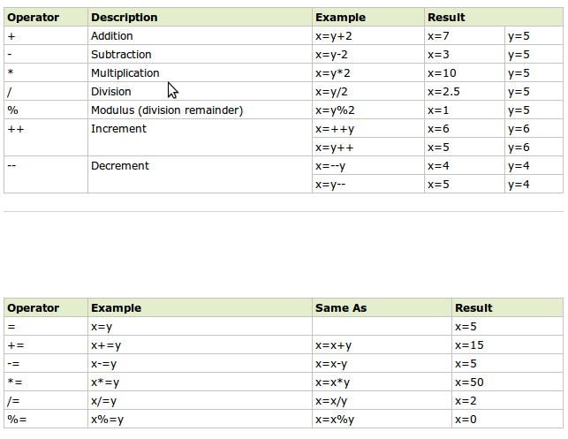
JavaScript Operators

Slide 9
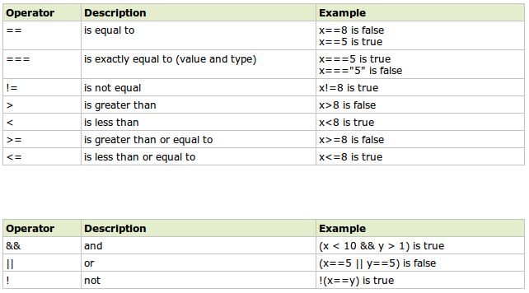

Slide 10
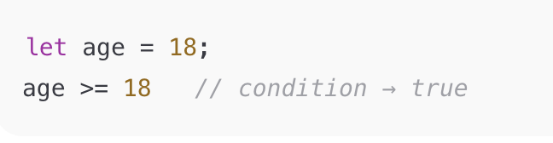
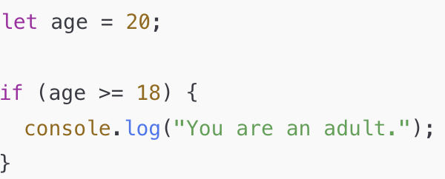
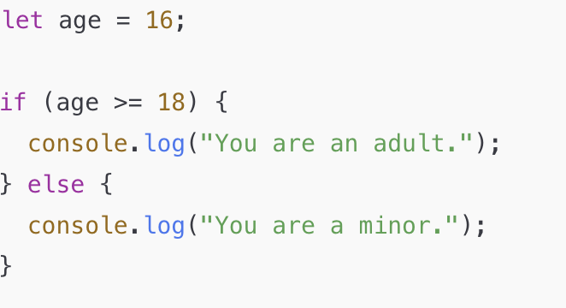
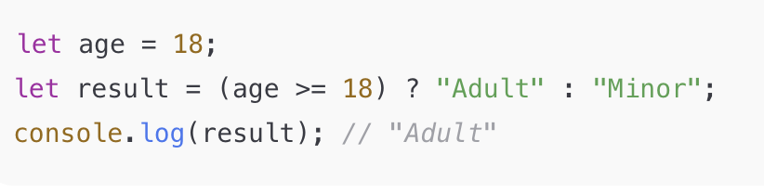
Conditionals & Loops
What is a condition? - A condition is simply an expression that results in a true or false value (a Boolean).
Conditional Statements - JavaScript provides several ways to handle conditions:
if Statement if...else Statement Ternary Operator (? :)
Notes:
let age = 18;
age >= 18 // condition → true

Slide 11
JavaScript Supports Switch Statement
const color = "green";
switch (color) {
case "red":
console.log("Stop");
break;
case "yellow":
console.log("Caution");
break;
case "green":
console.log("Go");
break;
default:
console.log("Invalid color");
}

Slide 12
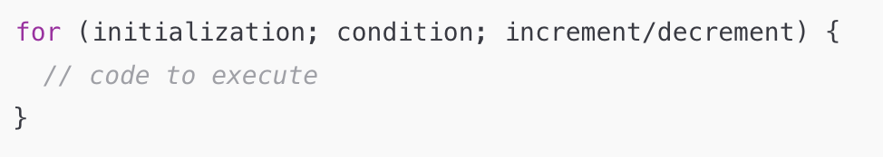
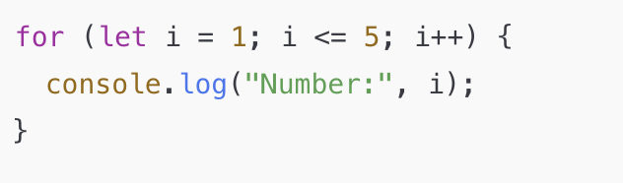
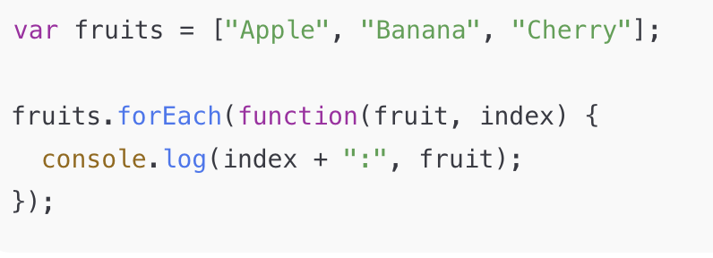
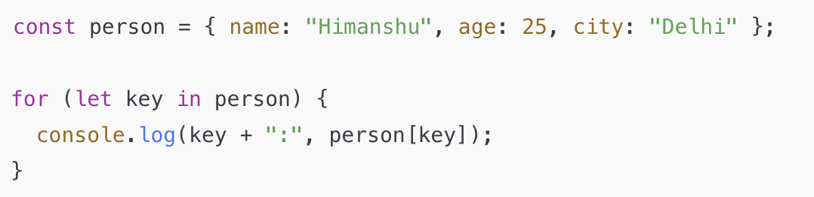
For Loop
For...each Loop
For...in Loop

Slide 13
Array
An array in JavaScript is a special variable that can hold more than one value at a time. It’s used to store multiple items in a single variable.
Key Features of Arrays
Ordered: Elements in an array are stored in an ordered sequence.
Indexing: Each element has an index, starting from 0.
Flexible: Arrays can store different types of data (e.g., numbers, strings, objects).
Creating an Array
// Using square brackets
const fruits = ["apple", "banana", "cherry"];
// Using Array constructor
const numbers = new Array(1, 2, 3, 4);

Slide 14
Accessing Array Elements
Access elements using their index:
const fruits = ["apple", "banana", "cherry"];
console.log(fruits[0]); // Outputs: apple
console.log(fruits[2]); // Outputs: cherry
Common Array Methods
Here are some commonly used methods:
1. Adding/Removing Elements
Push: Add to the end of the array.
fruits.push("grape"); // ["apple", "banana", "cherry", "grape"]
Pop: Remove the last element.
fruits.pop(); // ["apple", "banana", "cherry"]
Unshift: Add to the beginning.
fruits.unshift("orange"); // ["orange", "apple", "banana", "cherry"]
Shift: Remove the first element.
fruits.shift(); // ["apple", "banana", "cherry"]

Slide 15
const fruits = ["apple", "banana", "cherry"];
2. Finding and Replacing Elements
IndexOf: Find the index of an element.
console.log(fruits.indexOf("banana")); // 1
Includes: Check if an element exists.
console.log(fruits.includes("apple")); // true
Splice: Add, remove, or replace elements. - changes original array
fruits.splice(1, 1, "kiwi"); // ["apple", "kiwi", "cherry"] - replace
fruits.splice(1, 1); // ['apple', 'cherry'] - remove
fruits.splice(1, 0, "grape", "orange"); // ['apple', 'grape', 'orange', 'banana', 'cherry'] - add
3. Other Useful Methods
Concat: Combine two arrays.
const veggies = ["carrot", "potato"];
const food = fruits.concat(veggies);
Slice: Extract part of an array. - doesn’t changes original array
const sliced = fruits.slice(1, 2); // ["banana", "cherry"]
Join: Convert to a string.
console.log(fruits.join(", ")); // "apple, banana, cherry"
Sort: Sort elements alphabetically or numerically.
fruits.sort(); // ["apple", "banana", "cherry"]
Notes:
array.splice(startIndex, deleteCount, item1, item2, ...)

Slide 16
Example: Practical Use
const scores = [85, 90, 78, 92, 88];
let sum = 0;
for (let score of scores) {
sum += score;
}
const average = sum / scores.length;
console.log(`Average Score: ${average}`); // Average Score: 86.6
Advanced Array Methods
Map: Transform elements.
const doubled = scores.map(score => score * 2); // [170, 180, 156, 184, 176]
Filter: Select specific elements.
const highScores = scores.filter(score => score > 85); // [90, 92, 88]
Reduce: Accumulate values.
const total = scores.reduce((acc, score) => acc + score, 0); // 433
Notes:
array.reduce(function(accumulator, currentValue, currentIndex, array) {
// return new accumulator value
}, initialValue);

Slide 17
Objects
An object in JavaScript is a collection of key-value pairs. It's used to store data in a structured way, and each key (also known as a property) is unique.
Key Features of Objects
Key-Value Pairs: Data is stored as key-value pairs (e.g., name: "John").
Flexible: Can store values of any type (e.g., strings, numbers, arrays, or other objects).
Dynamic: You can add, update, or remove properties at any time.
Creating an Object
There are multiple ways to create objects:
1. Object Literal
var person = {
name: "John",
age: 30,
isMarried: false,
};
2. Using new Object()
var person = new Object();
person.name = "John";
person.age = 30;

Slide 18
Accessing Properties
1. Dot Notation
console.log(person.name); // "John"
2. Bracket Notation
Useful for dynamic keys or keys with special characters.
console.log(person["age"]); // 30
Deep copy :-var test=JSON.parse(JSON.stringify(person));
Modifying an Object
1. Adding a New Property
person.address = "123 Main St";
console.log(person.address); // "123 Main St"
2. Updating a Property
person.age = 35;
console.log(person.age); // 35
3. Deleting a Property
delete person.isMarried;
console.log(person.isMarried); // undefined

Slide 19
Common Object Methods
Object.keys(): Returns an array of keys.
console.log(Object.keys(person)); // ["name", "age", "address"]
Object.values(): Returns an array of values.
console.log(Object.values(person)); // ["John", 35, "123 Main St"]
hasOwnProperty(): Checks if a property exists.
console.log(person.hasOwnProperty("name")); // true

Slide 20
Nested Objects
Objects can contain other objects, arrays, or a mix of both.
const student = {
name: "Alice",
marks: {
math: 85,
science: 90,
},
};
console.log(student.marks.math); // 85
Example: Practical Use
const car = {
brand: "Toyota",
model: "Corolla",
year: 2020,
start: function () {
console.log(`${this.brand} ${this.model} is starting...`);
},
};
car.start(); // "Toyota Corolla is starting..."

Slide 21
Global Execution Context (GEC)
The Global Execution Context (GEC) is created as soon as a script starts executing. It manages the global scope and the global object.
Phases of GEC:
  Creation Phase:
    Memory is allocated for variables and functions.
    Variables are initialized with undefined.
    Function declarations are stored in memory with their definitions.
  Execution Phase:
    Code is executed line by line, assigning values to variables and invoking functions.
In the global scope, the this keyword refers to the Global Object.
Notes:
var a = "sdfdsf";
function abc(params) {
}
var abcfn = function(params) {
}

Slide 22
Global Object
The Global Object is an object that provides access to global variables, functions, and environment-specific features.
Global Object in Different Environments:
  Browser: The global object is window.
  Node.js: The global object is global.
Behavior in ES5:
  Variables declared using var in the global scope are added as properties of the global object.
  Functions declared in the global scope also become properties of the global object.

Slide 23
Scope
What is Scope?
In JavaScript, scope refers to the accessibility of variables, functions, and objects in different parts of your code. It determines where these variables and functions can be referenced or used.
Types of Scopes
Global Scope
Functional/Local scope

Slide 24
Global Scope
Before you write a line of JavaScript, you’re in what we call the Global Scope. If we declare a variable, it’s defined globally:
example : -
var a = 1;
// global scope
function one() {
alert(a); // alerts '1'
}

Slide 25
Functional/Local Scope
Variables declared within a JavaScript function, become LOCAL to the function.
example :-
var a = 1;
function two(a) {
alert(a); // alerts the given argument, not the global value of '1'
}
// local scope again
function three() {
var a = 3;
alert(a); // alerts '3'
}

Slide 26
Hoisting
Hoisting is a behavior in JavaScript where variable and function declarations are moved to the top of their containing scope during the compile phase. This means you can use variables and functions in your code before they are declared.
Example:-
function foo() {
console.log(a);
var a = 20;
console.log(a);
}

Slide 27
Hoisting
JavaScript only hoists declarations, not initializations. The below two examples demonstrate the same behavior.
Example:-
console.log(message);
greet();
var message = "Hi there!";
function greet() {
console.log("Hello, World!");
}
console.log(message);

Slide 28
This Keyword
In JavaScript, the thing called this, is the object that "owns" the current code.
The value of this, when used in a function, is the object that "owns" the function.
When a function is called without an owner object, the value of this becomes the global object.
var x = myFunction(); // x will be the window object
function myFunction() {
return this;
}

Slide 29
HTML5 APIs (Local,Session Storage and Cookies)
Local Storage
Features:
Stores data persistently in the browser.
Key-value pairs format.
Data is not deleted when the browser is closed.
localStorage.setItem('key', 'value'); // Save
var data = localStorage.getItem('key'); // Retrieve
localStorage.removeItem('key'); // Remove
localStorage.clear(); // Clear all

Slide 30
HTML5 APIs (Local,Session Storage and Cookies)
Session Storage
Features:
Similar to Local Storage but session-based.
Data is cleared when the tab is closed.
Ideal for temporary data storage.
sessionStorage.setItem('key', 'value'); // Save
var sessionData = sessionStorage.getItem('key'); // Retrieve
sessionStorage.removeItem('key'); // Remove
sessionStorage.clear(); // Clear all

Slide 31
HTML5 APIs (Local,Session Storage and Cookies)
Cookies
Features:
Stores small data (4KB), sent with each HTTP request.
Can be persistent (expires after a set time) or session-based.
document.cookie = 'key=value; expires=Fri, 31 Dec 2025 23:59:59 GMT; path=/'; // Set
var cookies = document.cookie; // Retrieve
document.cookie = 'key=; expires=Thu, 01 Jan 1970 00:00:00 GMT; path=/'; // Remove
Notes:
document.cookie = "username=Himanshu; expires=Fri, 04 Nov 2025 12:00:00 UTC; path=/";

Slide 32
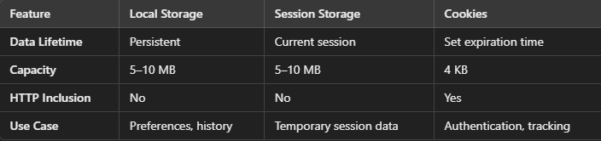
HTML5 APIs (Local,Session Storage and Cookies)
Comparison Table

Slide 33
JSON (JavaScript Object Notation)
JSON is a lightweight data format used for storing and exchanging data between a server and a client (typically in web applications).
It is text-based, easy to read, and can be easily parsed into a JavaScript object.
Format: JSON data is made up of key-value pairs (like a JavaScript object), but the keys must be strings, and the values can be strings, numbers, arrays, objects, or booleans.
var user = {
"name": "John Doe",
"age": 30,
"email": "john.doe@example.com",
"isAdmin": false,
"languages": ["English", "Spanish"]
};
// Accessing JSON data
console.log(user.name); // Output: "John Doe"

Slide 34
JSON (JavaScript Object Notation)
Parsing JSON
// Convert JSON string to JavaScript object
var jsonString = '{"name": "John", "age": 25}';
var userObject = JSON.parse(jsonString);
console.log(userObject.name); // Output: "John"
// Convert JavaScript object to JSON
string var user = { name: "John", age: 25 };
var jsonString = JSON.stringify(user);
console.log(jsonString); // Output: '{"name":"John","age":25}

Slide 35
AJAX (Asynchronous JavaScript And XML)
AJAX allows web pages to request data from a server asynchronously without reloading the page.
It is often used to update parts of a webpage with new data without the need for a full page refresh.
AJAX uses the XMLHttpRequest object (or fetch in modern JavaScript) to send requests and handle responses.
GET Request
var xhr = new XMLHttpRequest();
xhr.open("GET", "https://jsonplaceholder.typicode.com/todos/1", true); // Request type, URL, async flag
xhr.onreadystatechange = function() {
if (xhr.readyState === 4 && xhr.status === 200) {
var response = JSON.parse(xhr.responseText); // Parse JSON response
console.log(response);
}
};
xhr.send(); // Send the request

Slide 36
AJAX (Asynchronous JavaScript And XML)
POST Request
var xhr = new XMLHttpRequest();
xhr.open("POST", "https://api.example.com/submit", true);
xhr.setRequestHeader("Content-Type", "application/json"); // Set the content type
xhr.onreadystatechange = function() {
if (xhr.readyState === 4 && xhr.status === 200) {
var response = JSON.parse(xhr.responseText);
console.log(response);
}
};
var data = JSON.stringify({ name: "John", age: 30 }); // Prepare data as JSON
xhr.send(data); // Send the request with data
Live example: https://www.w3schools.com/xml/tryit.asp?filename=tryajax_first

Slide 37
Thank You

Slide 38
Exercise
https://docs.google.com/document/d/1AMShmgeqPNAlOMxF7cmaJS_zr5qajtoCLCTAdtSgIwY/edit?tab=t.0
https://mail.google.com/mail/u/0/#chat/dm/6iKC3cAAAAE

